Slide 1
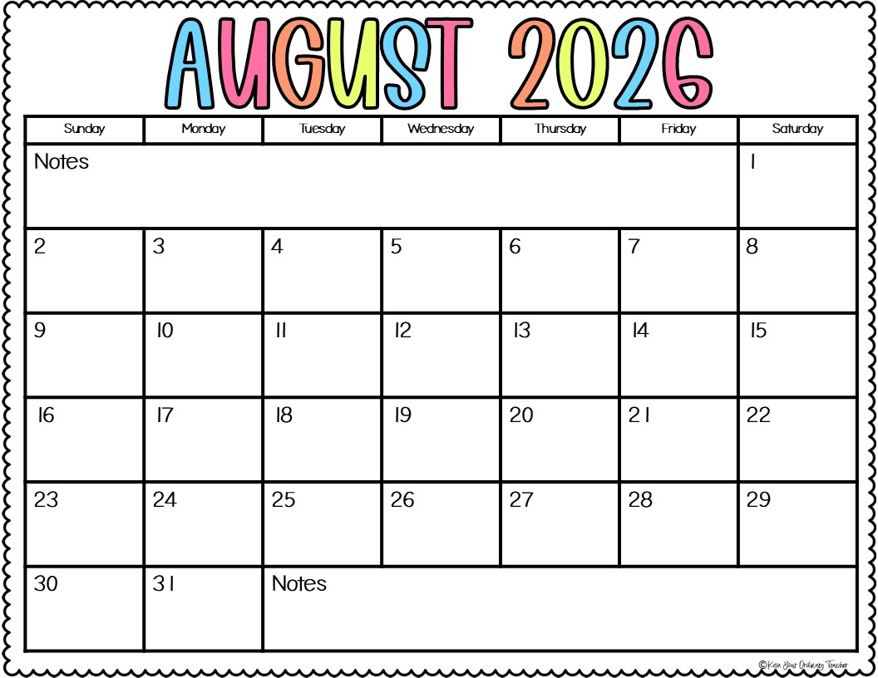
1st Day of School
Elementary
FastBridge Math
SAEBRs
Elementary
FastBridge/Capti Reading
Make-Up Testing

Slide 2
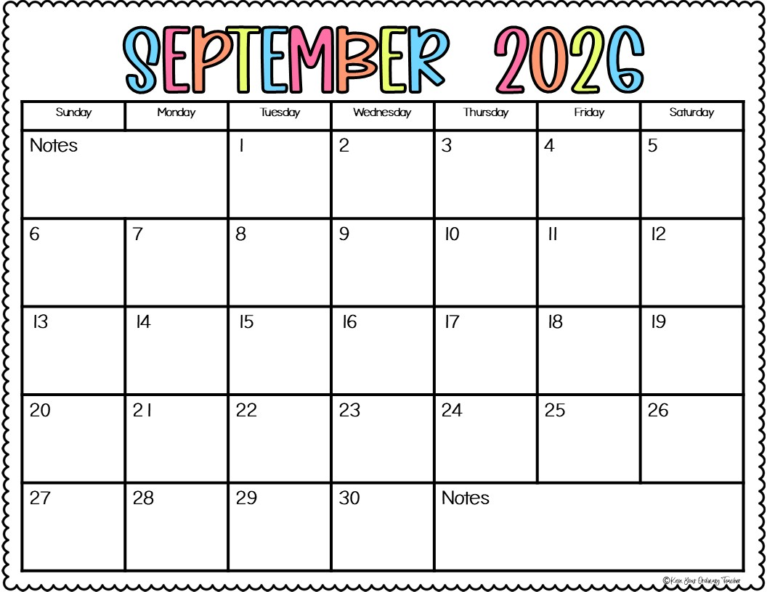
No School
No School
Secondary
FastBridge Math
SAEBRs
Secondary
Capti Read Basix
Make-Up Testing
No School

Slide 3
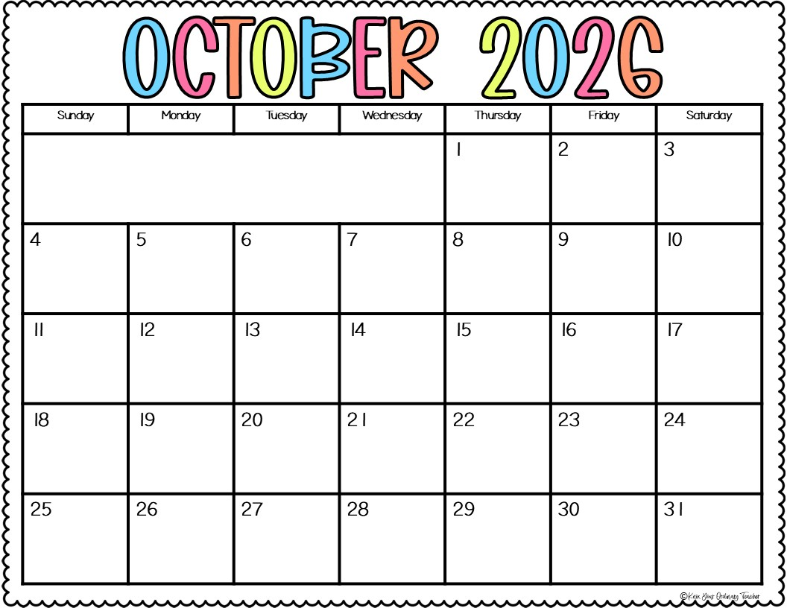
QTR 1 Ends
No School
No School
No School
Elementary
Conferences

Slide 4
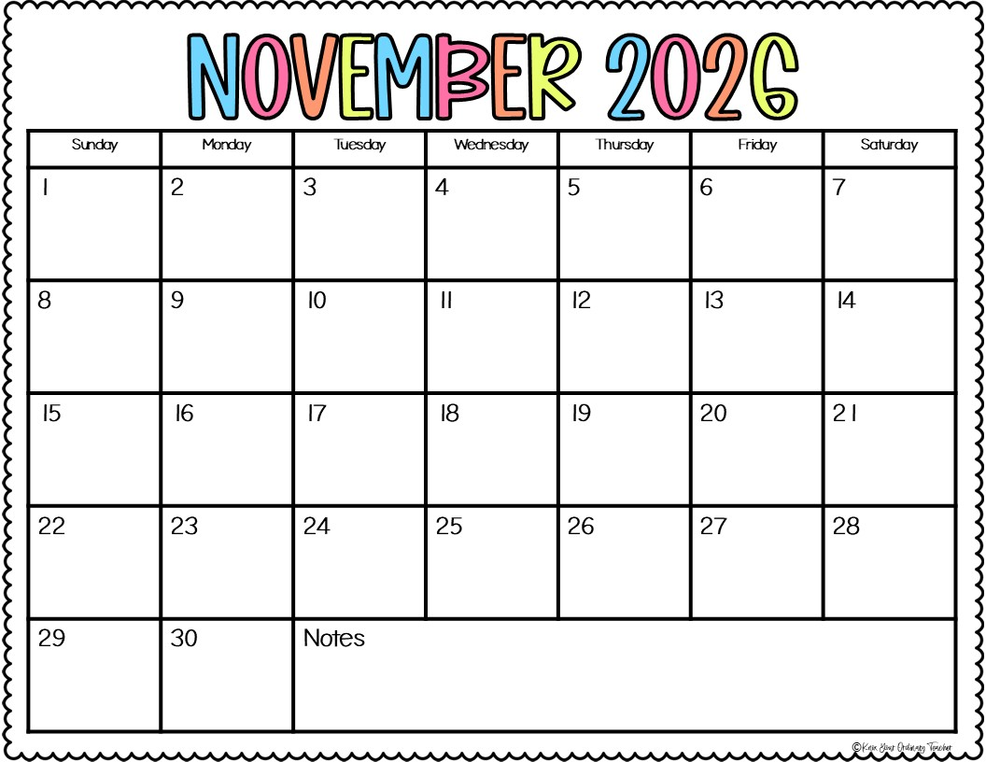
No School
No School
No School

Slide 5
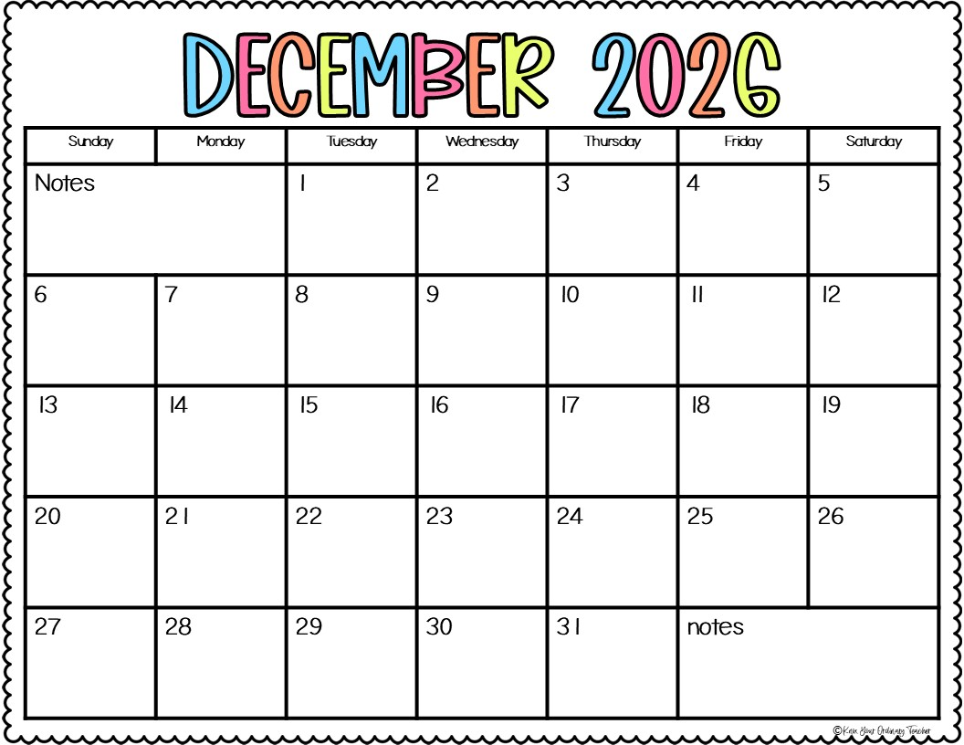
Elementary
FastBridge Math
SAEBRs
Elementary
FastBridge/Capti Reading
Make-Up Testing
Secondary
FastBridge Math
SAEBRs
Secondary
Capti Read Basix
Make-Up Testing
No School
No School
No School
No School
No School
No School
No School

Slide 6
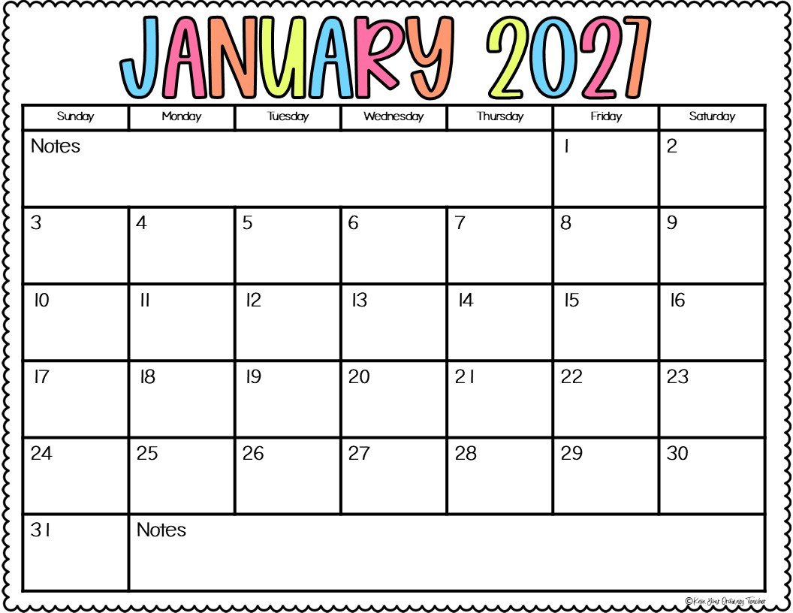
No School
No School

Slide 7
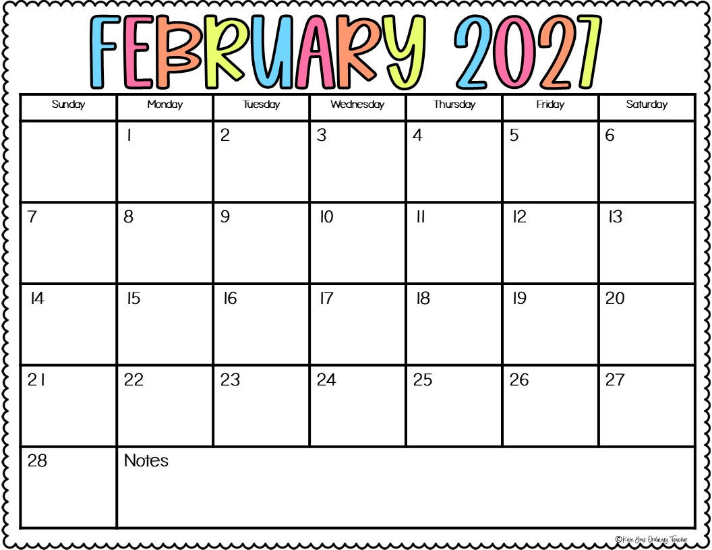
WIDA Access
Listening and Reading 8:30
WIDA Access Speaking and Writing 8:30
No School

Slide 8
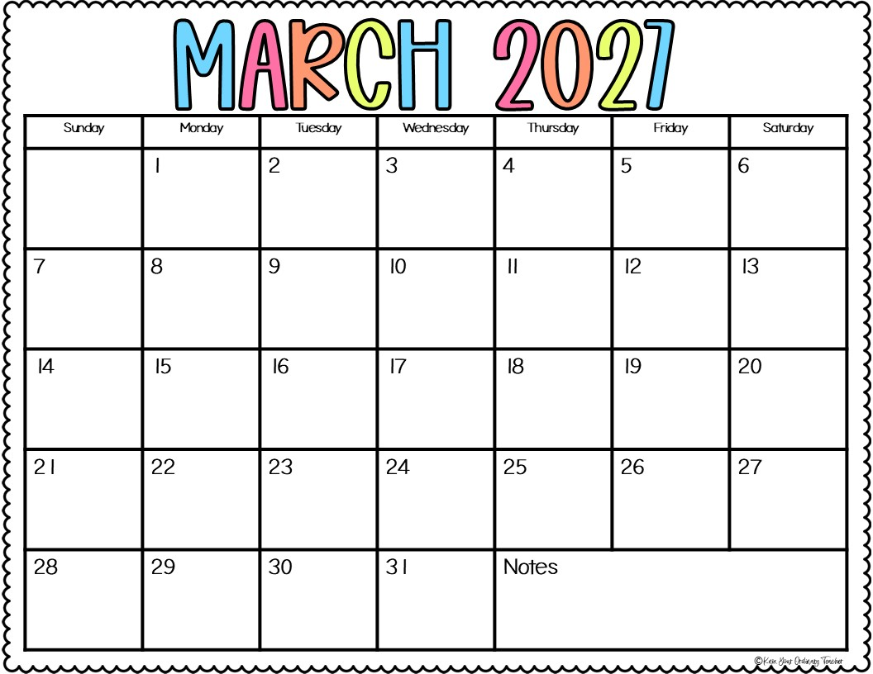
No School
No School
No School
No School
No School
No School
No School
No School
MCA Reading 3rd-5th grade
6-8th grade
10th grade
MCA Reading 3rd-5th grade
6-8th grade
10th grade

Slide 9
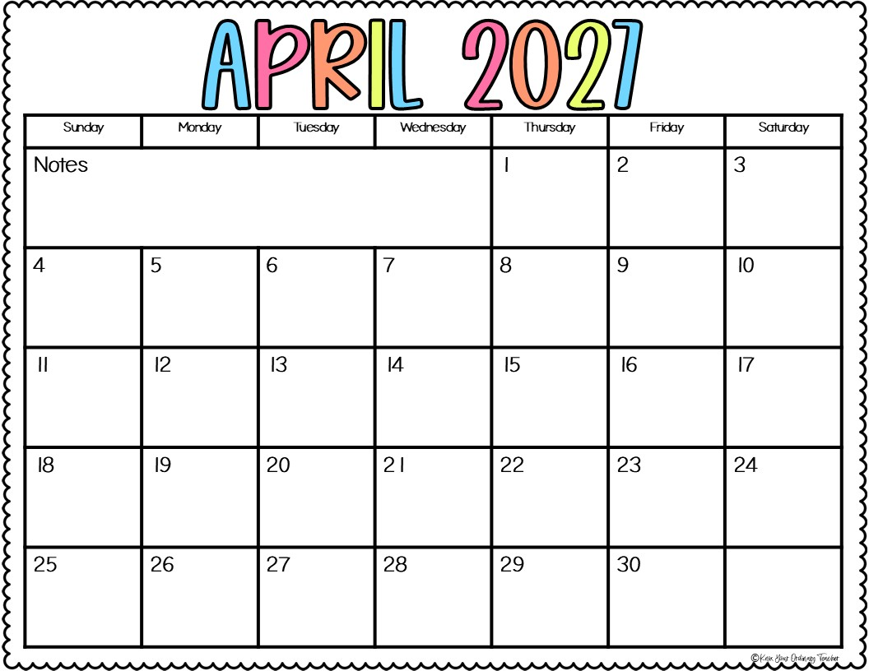
MCA Make-Up
No School
MCA Math 3rd-5th grade
6-8th grade
11th grade
MCA Math 3rd-5th grade
6-8th grade
11th grade
MCA Make-Up
ACT
MCA Science
5th, 8th and HS
MCA Science
5th, 8th and HS
MCA Make-UP
Elementary FastBridge Math
SAEBRs
Elementary FastBridge/Capti
Make-Up Testing

Slide 10
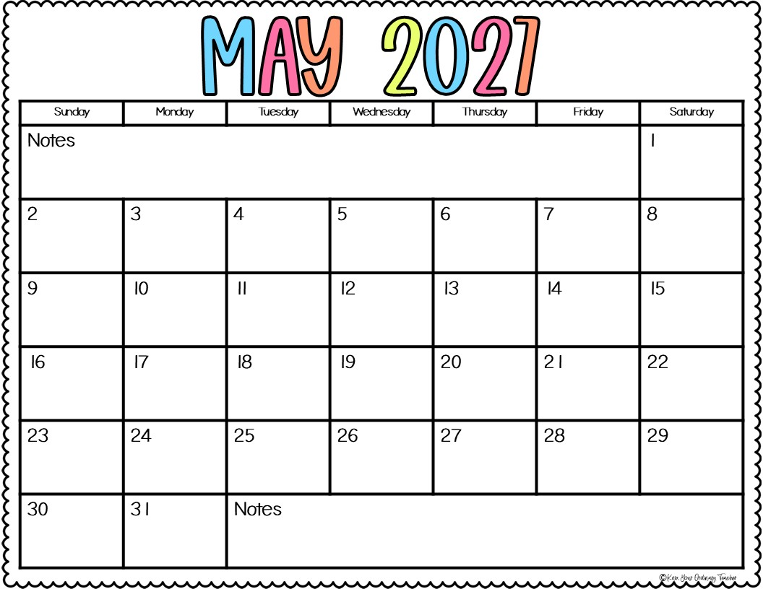
Secondary FastBridge Math
Secondary Capti Read Basix
Make-Up Testing
Elementary Last Day of School
Secondary Last
Day of School

Slide 11
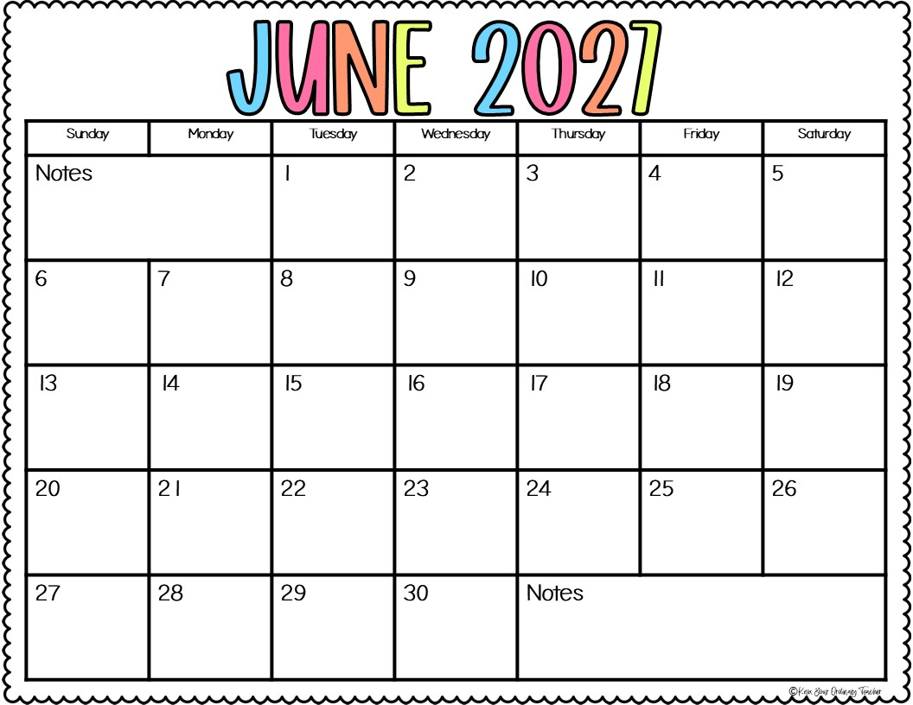
Local Literacy Plan Due

